Slide 1

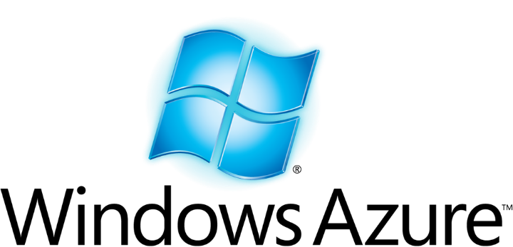

A Tale of Two Clouds
A side by side comparison of
Microsoft Azure and AWS
Andrew Siemer
Clear Measure
andrew@clear-measure.com
@asiemer

Slide 2







Andrew Siemer
http://about.me/andrewsiemer
ASP Insider
V-TSP
Father of 6
Jack of all trades, master of some.
Notes:
Andrew Siemer, obstacle races, ranching, shooting, has 6 kids

Slide 3
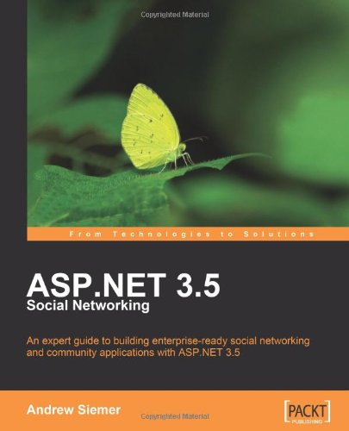
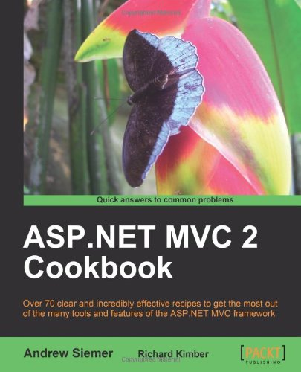
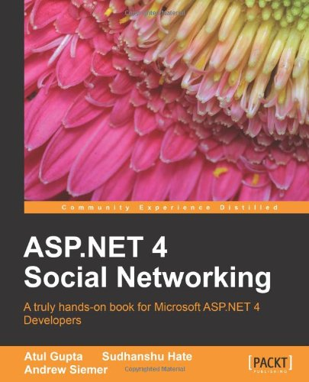

Notes:
Some books I have written or am writing

Slide 4




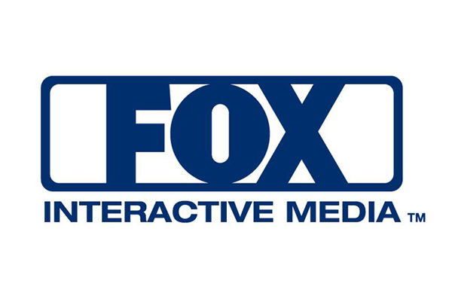






← We are hiring!!!
Notes:
Some places I have worked and some projects I have worked on

Slide 5
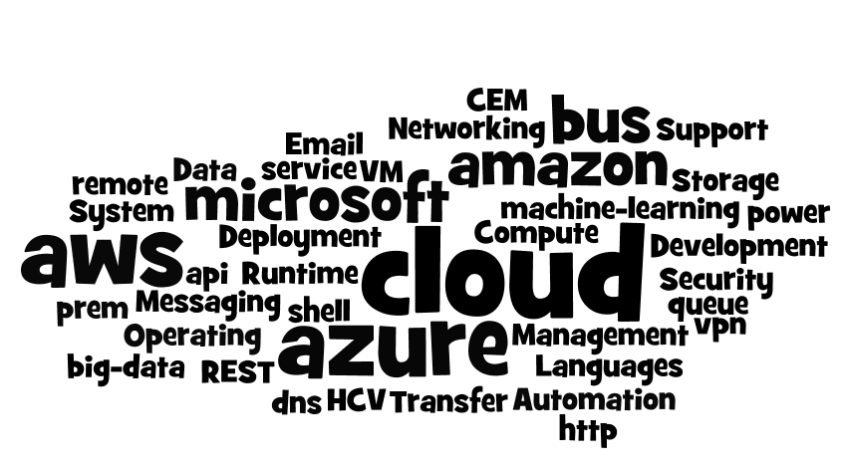
Introduction
Notes:
Today we are going to dig through at a very high level what the Microsoft Azure cloud and Amazon Web Services offer

Slide 6
Introduction
Deployment, Management and Automation
Compute
Storage
Messaging
Email
Networking
Security
Operating System & Data Transfer
Development Languages and Runtime Support
Notes:
More specifically we are going to look at the following concepts

Slide 7
What is a “cloud”?
Notes:
But first…what exactly do we mean when we say cloud?

Slide 8
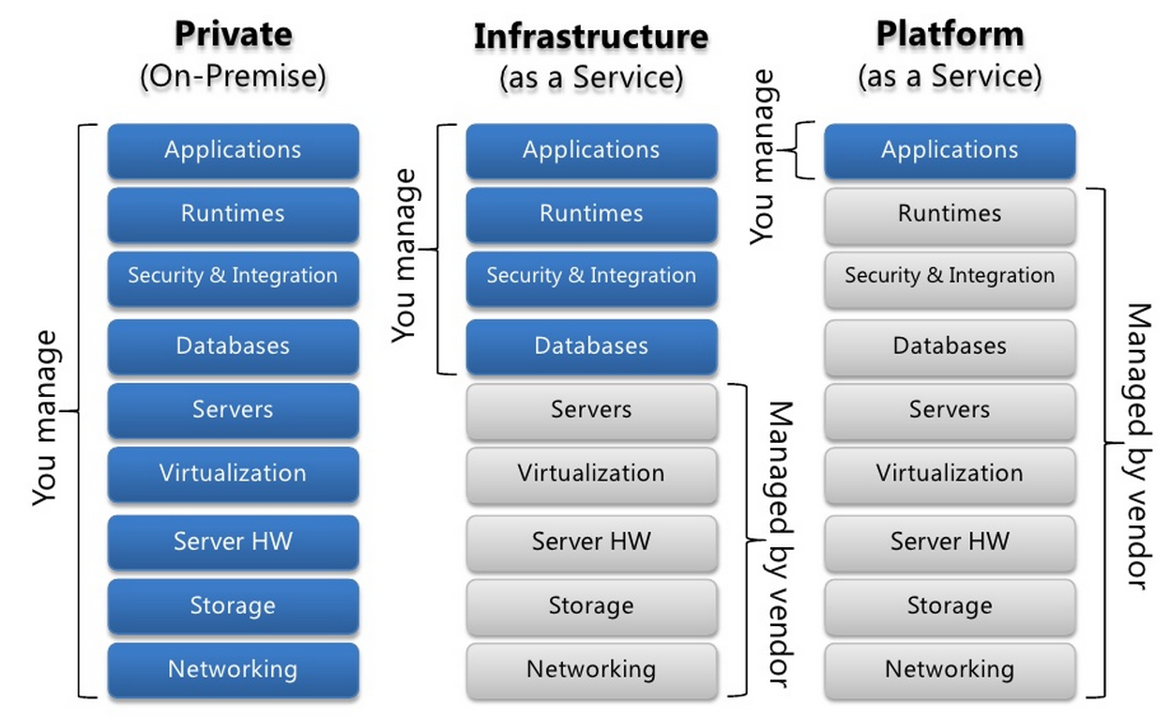
Types of clouds
Notes:
We first need to understand the offerings
Private: you own the app, the run times, and the hardware
IaaS: you own the app and the run times
PaaS: you own the app

Slide 9
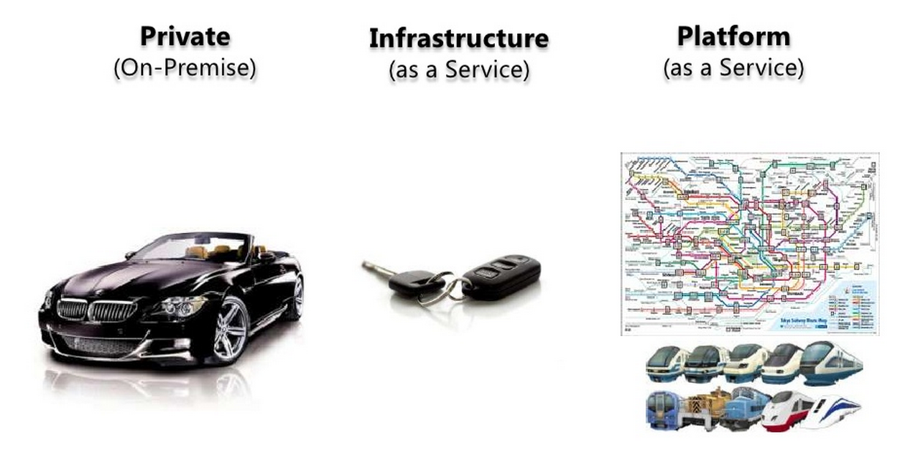
Types of clouds: Private
Notes:
Most company’s have played in the owning of the whole stack. We like to think that it is a shiny Beemer. But let’s face it – running the whole show is hard!

Slide 10
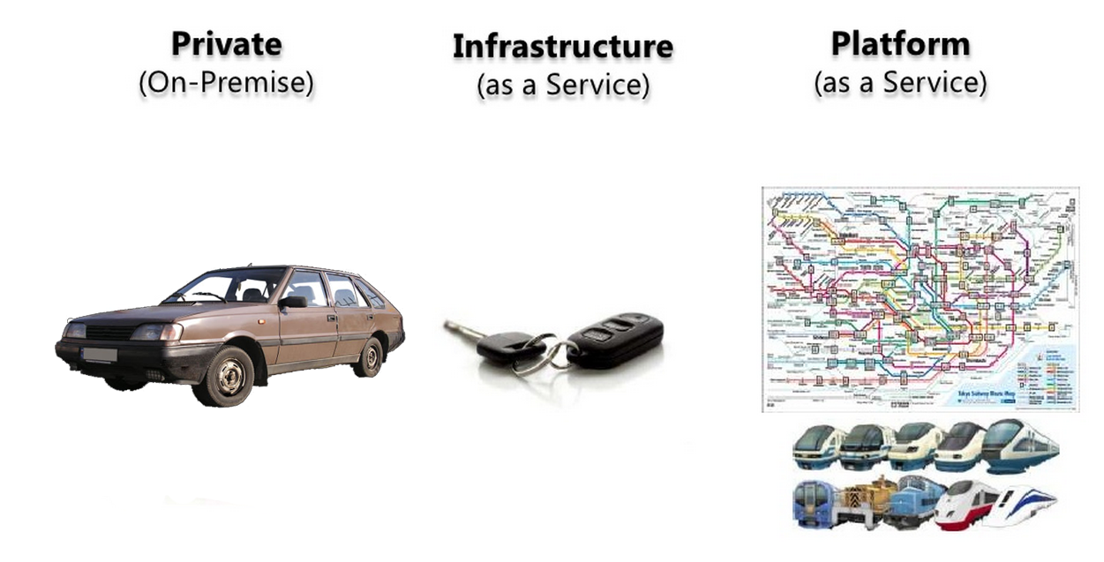
Types of clouds: Private
Notes:
And generally some small to medium companies, and even in some large ones, owning the whole stack doesn’t always turn out overly shiny and can be quite painful to drive.

Slide 11
Types of clouds: Infrastructure
Notes:
This leads many companys to a more virtualized environment. Where the hardware and the software concerns are somewhat separated. If hardware goes down, I can shift an image of a particular service somewhere else. The headaches are less. But you still have to manage the database, security, etc. And as it turns out those things are hard!

Slide 12
Types of clouds: Platform
Notes:
This eventually leads companies towards the cloud where many of the hard things are taken care of for you. But what if you could have the convenience of Platform story in your own data center most of the time? …and the ability to push that to the cloud when you need it?

Slide 13
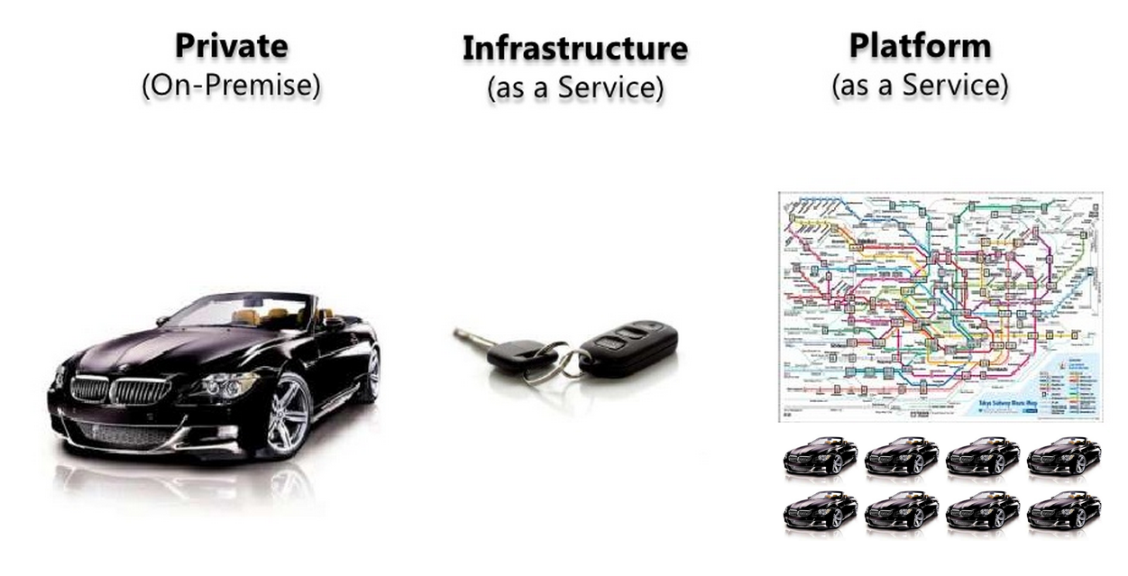
Types of clouds: Platform on prem

Slide 14
How does Azure and AWS fit?
Infrastructure As A Service (IaaS)
Platform as a Service (Paas)
Two years ago
Amazon Web Services
Microsoft Windows Azure
Now
Amazon Web Services
Microsoft Windows Azure

Slide 15

Compute

Slide 16

Deployment, Management, Automation

Slide 17
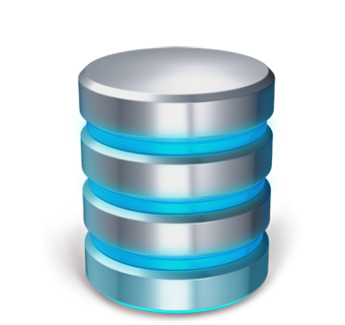
Storage

Slide 18

Messaging

Slide 19

Networking

Slide 20
Cloud Infrastructure
AWS
Azure
IP, Elastic IP, Elastic Load Balancer
Virtual Private Cloud
Route 53 (DNS)
Firewall
Virtual Network
Traffic Manager
Azure Load Balancer
No real DNS management
Firewall

Slide 21
On-prem Infrastructure
AWS
Azure
Direct connect
Azure pack
Site to site connection
Local to cloud connection
Web based provisioning
Scale up/scale out story
Local usage accounting
Linked active directories

Slide 22

Email

Slide 23
Email
AWS
Azure
Simple Email Service
Outbound only
Free: 62k emails
Great if send only
Integrates with other services
No inbound option
POP3 set up internally
SendGrid
Free: 25k emails
Inbound
Outbound
Great for marketing efforts
More feature rich

Slide 24
Email
Neither has a good “manage my business email” in the cloud story
You can set up an SMTP/POP3/IMAP in both easily
But wait - Microsoft Office 365
STMP/POP3/IMAP
Awesome integration with Office

Slide 25

Security

Slide 26
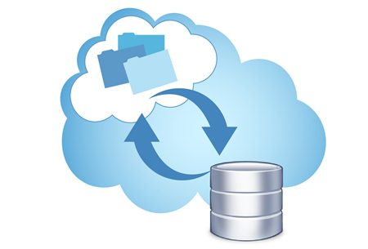
Operating System & Data Transfer

Slide 27
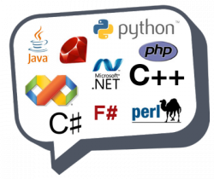
Development Languages & Runtime Support

Slide 28

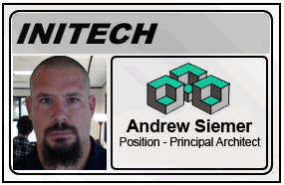
Any questions?
Andrew Siemer
Clear Measure
@asiemer

